Slide 1
Dealing with CyberBullying
A 21st Centruy Presentation by Angela Lin
2024 Nov 07
Notes:
Hello everyone, this is a presentation about cyber bullying in the 21st century.
My something awesome project studies cyber bullying, especially serious cyber bullying campaigns, and to analyse and create a framework on how we can deal with it.
In this presentation, I want to stress the fact that cyber bullying can happen to anyone, children, teens and adults alike.
I will be looking at a few cases is on how cyber bullying affects everyone and to bring more gravity to the word.

Slide 2
Project Overview:
Aim: To analyse serious cases of cyberbullying campaigns and to create a best practices list.
Method: Case Study Analysis, Anecdotes and Literature Review
Issues & what I learnt
Notes:
I hope to bring about this awareness on all age groups, since the word “cyber bullying” has its meanings diluted, and there is not enough awareness on how it affects adults without the tools to deal with this.

Slide 3
definition
Cyberbullying is when technology is used to hurt or embarrass someone or to make them afraid (Victoria Government Department of Health, 2024). It can affect everyone, including children, teens and adults (Cyberbullying Research Centre, 2011).
Cyberbullying campaigns are an extreme form of cyberbullying. It is defined in my research as an effort (organised or otherwise) to popularise misinformation or private information about a victim online, with the intent to harm the victim’s reputation or distress them psychologically.
Characteristics shared with cyber bullying:
1. Primarily psychological
2. Attacks social status
3. Can occur 24 hours a day (BackgroundChecks.org, 2024)
Notes:
Definition taken from:
https://www.betterhealth.vic.gov.au/health/healthyliving/Cyberbullying
https://cyberbullying.org/advice-for-adult-victims-of-cyberbullying

Slide 4
PREVALENT ACROSS ALL AGE GROUPS
In 2020, a study over 20,000 people indicated that 40.5% of young adults reported that they had been cyberbullied. (APS, 2020)
44% of Australian young people ages 12-17 report having a negative online experience in the last 6 months (eSafety Commissioner, 2021).
Trends: Cyberbullying exists in all age groups, decreasing with age.
(Data based on APS, 2020)
Notes:
https://www.esafety.gov.au/key-topics/cyberbullying#download-the-cyberbullying-quick-guide
https://www.liebertpub.com/doi/10.1089/cyber.2019.0146

Slide 5
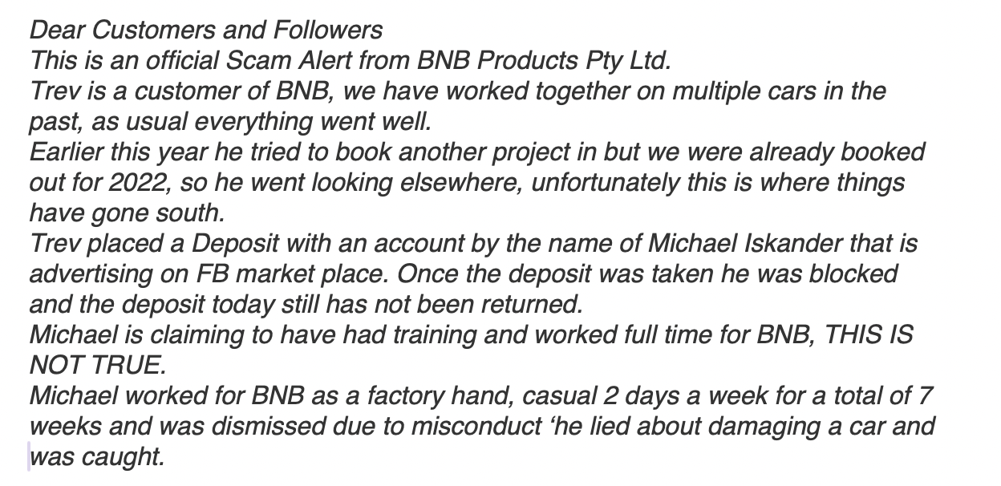
CASE: Iskander v Barcos [2023] VCC 2074
Summary: In 2022, Auto trimmer Michael Iskander was falsely accused by his former employer, David Barcos of BNB Autohaus, for scamming a customer (StonegateLegal.com 2024).
Situation and Target: Barcos posted on his business Facebook page defaming Iskander, targeting Iskander’s business reputation.
Impact & Resolution: The business Facebook page had 20,000 followers and this could severely damage Iskander’s livelihood and reputation. As such, Iskander sued Barcos, Barcos defaulted.
The judge found fabricated evidence and
malicious intent to harm Iskander’s business,
and awarded $90,000 in damages.
Notes:
https://stonegatelegal.com.au/social-media-defamation-complete-guide/

Slide 6
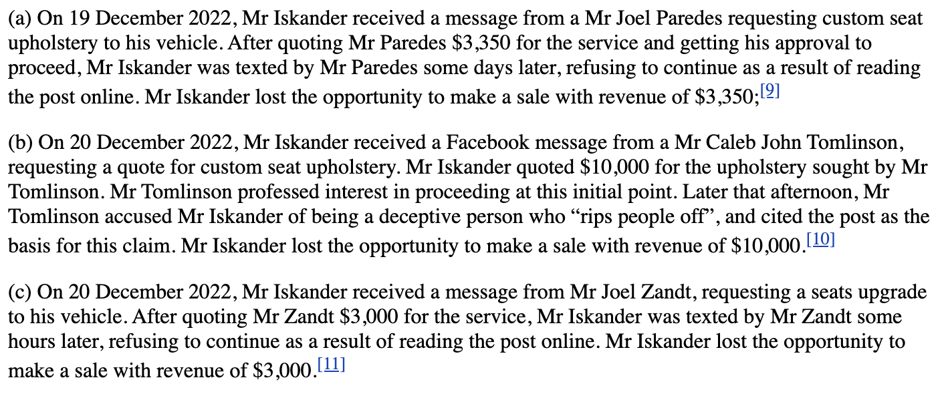
LESSONS: Iskander v Barcos [2023] VCC 2074
PREVENTION & PROACTIVE MEASURES ON AVAILABILITY AND INTEGRITY:
Screenshot/record evidence to ensure that it is available and cannot be tampered with/deleted
Consulting lawyers and using the appropriate legal tools, including defamation act and the serious harm threshold to ensure integrity of business and reputation is mended.
NOTE: This is a case where the perpetrator is identifiable and the intent is clear.
Loss of business opportunities (Austlii, 2022)
Notes:
https://www.stalkerexposed.com/2017/03/31/help-arrives-6/

Slide 7
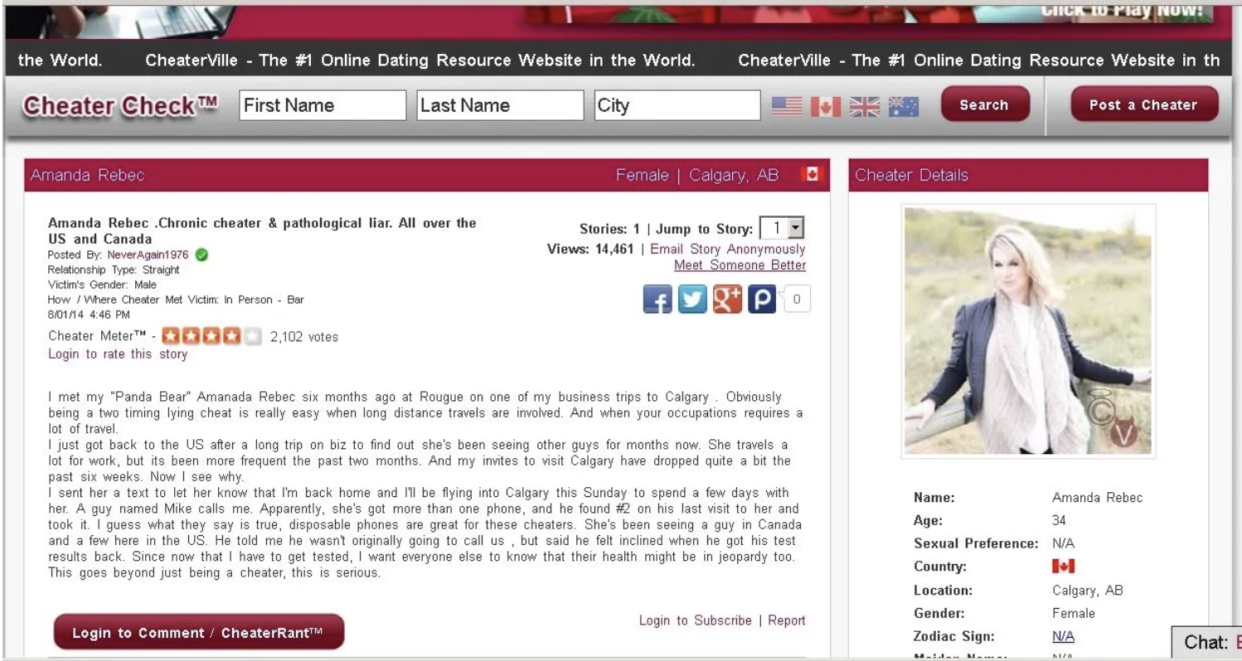
CASE: Amanda Nickerson
Summary: Amanda Nickerson, with a 17-year career in the oil and gas industry was cyberstalked for 2 years (2014-2016).
What happened:
Attacker created fake profiles on escort sites, cheater sites, fake social media sites
Attacker threatened her over the phone and physically sent mail to company to harass her
Attacker moved on to attack her friends and family and created false reviews for her company
Attacker demands that she break up with her boyfriend in return for stopping the attack
What was under attack:
Her reputation, professionally and personally
Her health, especially mental health
Her personal relationships and support system
Her company’s reputation and her livelihood

Slide 8
CASE: Amanda Nickerson
Impact:
- Loss of reputation “walk into business meetings and … asked about intimate things”
Loss of livelihood - “I ended up losing contracts and ultimately my job.”
Psychological distress – “I couldn’t trust anyone around me.”
- Betrayal/loss of support from others - “Some even exploited the situation to pressure me for money, blaming me for the impact my stalker had on their lives.”
Resolution:
- Unfortunately, the police and FBI could not help her since her case was low priority compared to child pornography or murder.
- She did not give into the demands of the attacker and wrote a blog to detail her experience and share her voice. She had friends and family who were supporting her.
- A forensic cyber investigator and crime analyst took her case and helped her increase operational security and helped her regain mental resilience.
- After two years, the cyber stalker apologized on tumbler and stopped suddenly.

Slide 9
LESSONS: Amanda Nickerson
PREVENTION MEASURES ON CONFIDENTIALITY, INTEGRITY AND AUTHENTICITY:
Remove metadata from public photos and to make sure they are all watermarked
DMCA take down of unauthorised use of copyright images on social media sites
Password protections:
Strong passwords and 2-step authentication for sites
Different passwords for personal and work, and change all passwords
Install a password keeper
Control your narrative - “…bolster your legitimate online presence and keep it up to date. The less there is online about you, the easier it is for trolls and stalkers to make your life difficult. Laws lag far behind modern tech… you’ll end up having to hire lawyers to do takedowns.” (H. Vescent & N. Selby, 2020)
Note: This is a case where the attacker changes a variety of tactics, but their true intention doesn’t surface until they issued the ultimatum a few months later.
Notes:
https://www.stalkerexposed.com/2017/03/31/help-arrives-6/

Slide 10
CASE: Zhu Yilong
Summary: Sudden fame for actor of 10-year career. A myriad of cyberbullying attacks happened to the actor, his fans and his reputation.
What happened:
Attacker used bots and paid media accounts to push mean comments and bad reviews on the actor’s appearance and acting ability on social media
Brands associated with the actor have been harassed on social media.
Brand collaboration event was infiltrated, and a demeaning stream was conducted by the host and released online, calling the actor “old and ugly”
”Hidden marriage” rumours and fandom wars created by paparazzi, paid media accounts and professional trolls
What was under attack:
Actor reputation
Actor financials – sponsorships
Actor Fanbase

Slide 11
CASE: Zhu Yilong
Impact & Aim | Resolution
Negative reviews bring down the rating of the actor’s shows, dissuading others from watching | The actor responded in interviews, speaking of producing better performances and better shows for the audience and instead of responding to negative comments on social media. Fans self-opted into posting more positive pictures and reviews.
Aims to frighten or scare away sponsors that support the actor | Brand team did not falter under pressure, they moderated comment sections. Continued sponsorship due to increased returns from sponsorship
Host dissed the actor on brand-endorsed stream and created a deeply offensive blow to actor’s reputation | Brand team issued a stamped formal apology on social media as quickly as possible. However, both Zhu Yilong and the brand’s reputation and commercial value were impacted.
”Hidden marriage” rumours and fandom wars by paparazzi and professional trolls | Actor did not respond to this allegation on social media. Industry professionals gave Zhu Yilong a stage to dispel rumours. Fandom adopted ” Attention is precious, don’t give them any attention” to professional trolling.

Slide 12
LESSONS: Zhu Yilong
Key Lessons:
The actor focused on making industry connections and creating better performances, instead of responding to trolling or baiting comments on social media, which are short-term in comparison. This enhances authenticity and integrity.
Support networks/key stakeholders close to the victims may be caught in the crossfire. This is an uncomfortable possibility, and one that the victims and their support networks need to consider.
Unfortunately, insider attacks are hard to prevent. In this case, it is possible that the brand did not take the sponsorship seriously and did not employ a trusted host for the stream.
Keeping private life private when possible. Not all allegations need to be responded to.
Robust industry network and friends can help clear the air and dispel rumors.
Notes:
https://www.stalkerexposed.com/2017/03/31/help-arrives-6/

Slide 13
The Crux of Cyberbullying
Intent to hurt and accessing any avenues to hurt.
Preventing access is key.
Access to private accounts (including breaking in, password access)
Access to private chats and images (including photos, and texts)
Access to personal information (home address, phone number, email address)
Access to real-time information (real-time location)
Knowing what matters to the victim (key stakeholders in victim’s lives, including support network and network), and access to the stakeholders (e.g. company address/email, company review page, colleagues’ contacts, fan groups, and forums)
Access to social media inbox (youtube/facebook/twitter/Instagram inbox, game ID etc.)
Utilisation of public space and influence to accuse someone of something, for example, to fill the news and internet space with information about them (this requires platform moderation, platforms need to provide tools for users to take control of their content)

Slide 14
What Can I Do? One, Two, Three!
One, protect: #Prevent Access and Bolster Authenticity!
Two, defend: #Keep evidence and seek professional help
Three, protect others: #Take care of yourself & say no to cyberbullying!

Slide 15
What Can I DO - Details
Keeping yourself safe physically and mentally is the top priority.
One, Protect yourself:
Keep operationally safe (privacy, private life and details, protect your passwords), 2FA, read up on privacy settings for social media, be aware of what info you agree to give
Selective and careful interaction online, be careful about engaging in debates and take control by blocking and reducing exposure to mean comments. Moderated communities provide a layer of protection.
Monitor mood when browsing online, close the connection and say ‘no’ to negativity
Build up support network and bolster a strong narrative of your personal brand online and in real-life (e.g. with your colleagues).
Setting strong boundaries between real-life and online
#Prevent Access and Bolster Authenticity!

Slide 16
What Can I DO - Details
Keeping yourself safe physically and mentally is the top priority.
Two: Defend yourself:
Do not handle cyber bullying alone, find trusted friends, family or professionals
Gather evidence or have a trusted party help gather evidence
Utilise all available tools when under distress, including platform policy, legal, police, cyber professionals.
Three: Protecting others:
Gather evidence, assist in reporting or providing information can help tremendously.
Cyber bullying can happen to anyone. Fostering a culture that does not tolerate this is important. Speaking up and speaking out about others can help.
However, this might not always be possible, as culture is a slow process. In the meantime, step away from any involvement with cyberbullying, or any groups that condone it.
#Keep evidence and seek professional help
#Take care of yourself & say no to cyberbullying!

Slide 17
References
Australian Government (2022). How eSafety can help | eSafety Commissioner. [online] eSafety Commissioner. Available at: https://www.esafety.gov.au/key-topics/illegal-restricted-content/how-esafety-can-help [Accessed 4 Nov. 2024].
Australian government (2024). Cyberbullying. [online] eSafety Commissioner. Available at: https://www.esafety.gov.au/key-topics/cyberbullying.
Backgroundcheck.org, (n.d.). Cyber Bullying: The Definitive Guide for Educators, Parents, and Family Members | backgroundchecks.org. [online] Available at: https://backgroundchecks.org/cyber-bullying-helping-the-bullied-stopping-the-bullies.html.
Better Health Channel (2012). Cyberbullying (online bullying). [online] Vic.gov.au. Available at: https://www.betterhealth.vic.gov.au/health/HealthyLiving/Cyberbullying.
Davis, W. (2024). Social Media Defamation – Complete Guide. [online] Stonegate Legal. Available at: https://stonegatelegal.com.au/social-media-defamation-complete-guide/.

Slide 18
References
Jiang, X. Y. (2021). ‘饭圈文化’影响下粉丝群体的网络民族志研究——以朱一龙粉丝群体为例. 文化产业, [online] 0(2), pp.P.63-66. Available at: https://www.zhangqiaokeyan.com/academic-journal-cn_culture-industry_thesis/0201291733309.html [Accessed 4 Nov. 2024].
McLean, S. (2014). Sexts, Texts and Selfies. Melbourne, Australia: Penguin Group Australia, pp.67–81.
Netease (2020). 彭青造谣朱一龙不敬业，私生为澄清晒剧本，这次该给私生记一功！. [online] 163.com. Available at: https://www.163.com/dy/article/FNS8RHRV0537GMOI.html [Accessed 4 Nov. 2024].
Nickerson, A. (2017). My Life Exposed. [online] My Life Exposed. Available at: https://www.stalkerexposed.com/2017/08/10/august-10th-day-started-day-will-end-8/ [Accessed 4 Nov. 2024].
Patchin, J.W. (2015). Advice for Adult Victims of Cyberbullying. [online] Cyberbullying Research Center. Available at: https://cyberbullying.org/advice-for-adult-victims-of-cyberbullying.

Slide 19
References
Peng, Z., Pu, Y. and Song, Y. (2022). From ‘Fans for Idols’ to ‘Fans for Nation’: Review on Fandom Nationalism in China. Advances in Social Science, Education and Humanities Research, 618. doi:https://doi.org/10.2991/assehr.k.220110.196.
Romano, A. (2020). What we still haven’t learned from Gamergate. [online] Vox. Available at: https://www.vox.com/culture/2020/1/20/20808875/gamergate-lessons-cultural-impact-changes-harassment-laws.
Selby, N. and Vescent, H. (2020). The CYBER ATTACK SURVIVAL MANUAL. California, USA: Weldon Owen, Incorporated, pp.50–51, 151–161.
Xie, T.W. (2022). 2022 Chinese Fans Economi Overview. [online] China: Lead Leo, pp.1–46. Available at: https://pdf.dfcfw.com/pdf/H3_AP202303241584545074_1.pdf [Accessed 4 Nov. 2024].

